Slide 1

Data Types and Structured Data
API Documentation 1: JSON and XML
How do you describe data?

Slide 2
Introduction
This Lecture Covers
Data types
Booleans
Data collections
Structured data

Slide 3
Data Types
In programming, data can have certain types:
Integer numbers
Decimal numbers
Text
True/false
Dates
Custom types

Slide 4
Data Types, continued
JSON has three types:
Number
String
Boolean
XML has one type
String

Slide 5
String
Strings are a number of text characters “strung” together
Enclosed in double or single quotation marks
Can have letters, numbers, punctuation, etc.
Can have spaces
Examples:
"Peter"
"3345-3457-3489"
"We hold these truths to be self-evident"

Slide 6
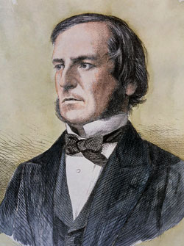
Boolean
Boolean math is the math of true and false
Booleans have only two values:
true
false
George Boole

Slide 7
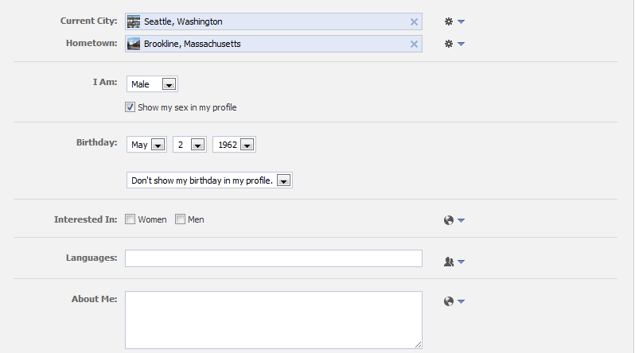
Find the data types

Slide 8
Collections
In addition to data types, structured data can have groups of data.
There are two common types:
Arrays (lists)
Dictionaries(look up tables)

Slide 9
Arrays
An array is a list of data values
Arrays have:
A size (how many are in the list)
An order (which object comes first)
Examples:
List of numbers: 5, 2, 60, -7, 1, 6.5, 0
List of strings: "John", "Paul", "George", "Ringo“
You can have lists of lists!

Slide 10
Dictionaries
A dictionary is a collection of data keys and values
You use the key to look up the value
Just like in a dictionary, you use the word to look up the meaning.
Examples:
Dictionary of US regions (keys) and number of states in that region (values)
"West":6, "North East":10, "South":8, "Midwest":10

Slide 11

Structured data
You can have:
Dictionaries of lists
Lists of dictionaries
Dictionaries of dictionaries
Etc. As many levels as you need
This is what structured data is
It can be a very complex tree of data

Slide 12


Structured Data and APIs
API request
API response
API responses almost always have structured data
API requests sometimes have structured data

